Slide 1



SOUTHWEST OHIO
PREHOSPITAL CARE
CLINICAL PRACTICE GUIDELINES
2023
UPDATE
ACADEMY OF MEDICINE OF CINCINNATI PROTOCOLS

Slide 2
Introduction
  Training is designed to familiarize the EMS provider with the use and content of new and revised protocols
  The protocols will continue to evolve as medicine changes and care is reviewed.
  Provides quality improvement standards

Slide 3
ALL EMS providers shall be responsible to read and review each protocol and policy in its entirety

Slide 4
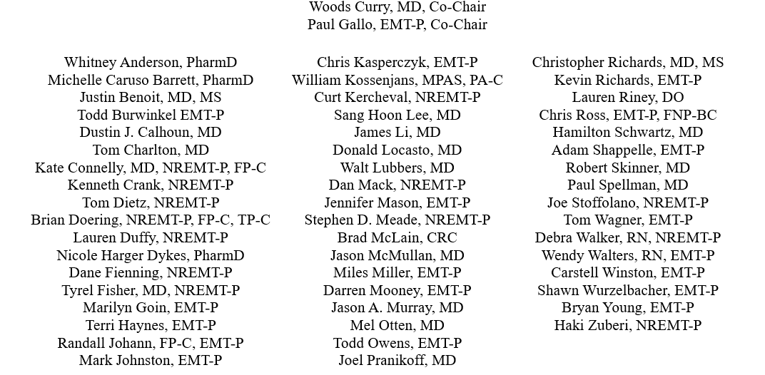
Protocol Committee

Slide 5
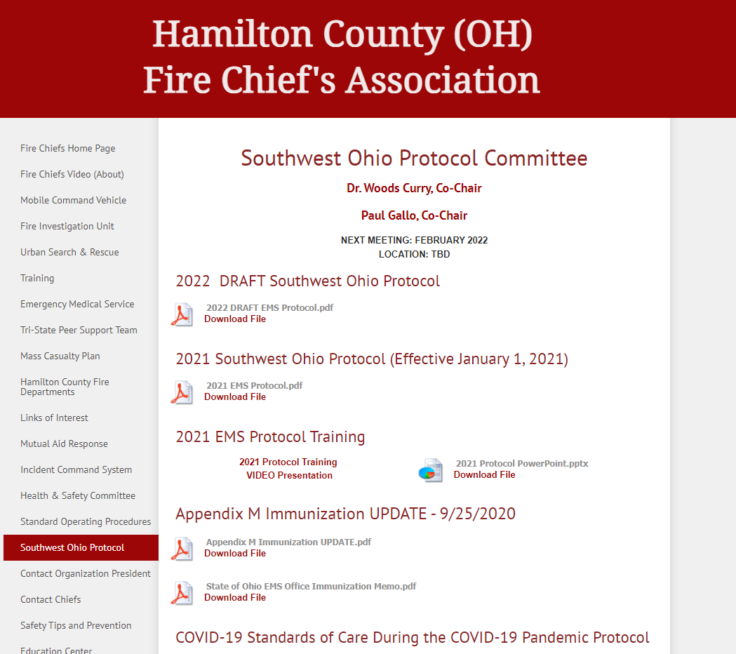
Website Location
www.hamiltoncountyfirechiefs.com

Slide 6
New Protocols
  SB215 Refusal of Treatment and/or Transport
  M422 Legal Situations Involving EMS

Slide 7
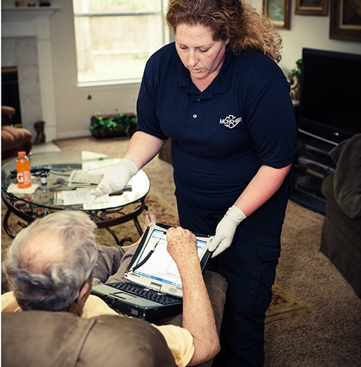
SB215 Refusal of Treatment and/or Transport

Slide 8
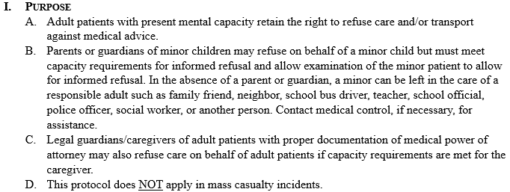
SB215 Refusal of Treatment and/or Transport

Slide 9
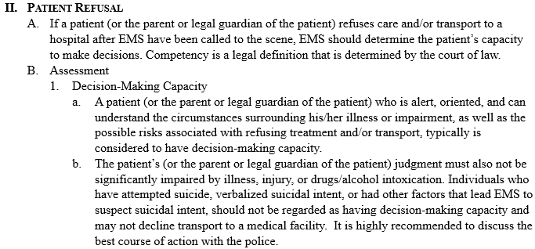
SB215 Refusal of Treatment and/or Transport
Notes:
Emphasize “it is highly recommended to discuss the best course of action with police.”

Slide 10
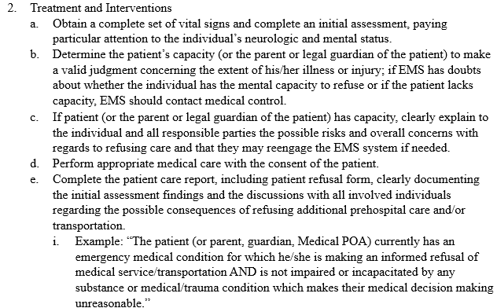
SB215 Refusal of Treatment and/or Transport

Slide 11
M422 Legal Situations Involving EMS
Suspected child abuse
Elder abuse
Crime scene management
Suspected sexual assault
Discuss with your PD!

Slide 12

M422 Legal Situations Involving EMS
Definitions
Reporting requirements
HIPAA
Notes:
In cases of suspected abuse, one member of the crew must report the suspected abuse to the proper authorities. This may include local law enforcement, a state department tasked with this responsibility, or to an investigator with Child Protective Services. Hotline phone numbers for Ohio, Kentucky, and Indiana included.
When documenting physical findings, avoid attempting to document the age of the bruising or injury, and what you suspect caused the injury. Document objectively what you find. You are not required to perform an investigative exam with measurements and photographs.
The EMS crew must report their suspicions of abuse to either the nurse or physician assuming care of the patient in the Emergency Department.
Investigators may request additional information following a verbal report. These disclosures are expressly permitted by HIPAA.

Slide 13

M422 Legal Situations Involving EMS

Slide 14
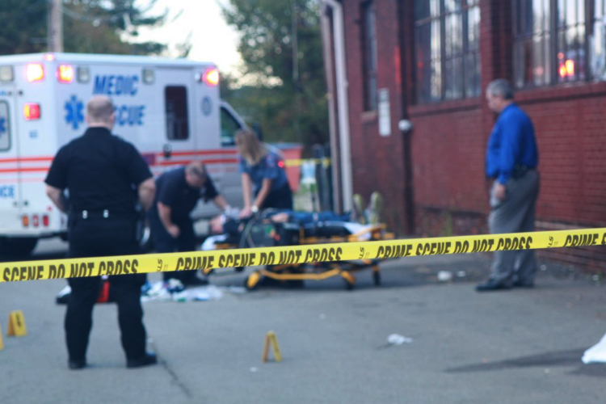
M422 Legal Situations Involving EMS

Slide 15

M422 Legal Situations Involving EMS
Avoid restroom use, eating, drinking, chewing gum, brush teeth, or use mouthwash
Avoid FSBG and IV procedures
Note which arm vitals are performed
Avoid details about assault

Slide 16


Slide 17

Reviewed
A110 Highly Infectious Disease Transport
M417 Adrenal Insufficiency
P617 Pediatric Psychiatric Protocol
P618 Pediatric Restraint Protocol
T703 Emergency Use of Central Access Device (CVAD) and Fistula
App F Dog/Cat Care

Slide 18
A106 Do Not Resuscitate Orders in the Field
Notes:
House Bill 138 was signed into law on April 6 and became effective July 6.
*** EMS can now recognize DNR orders signed by a physician assistant or advanced practiced register nurse I.

Slide 19
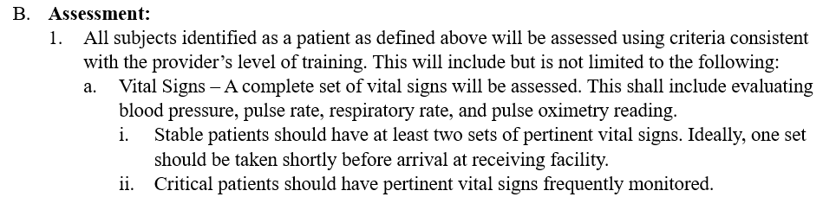
SB200 Clinical Practice Standards for EMS

Slide 20
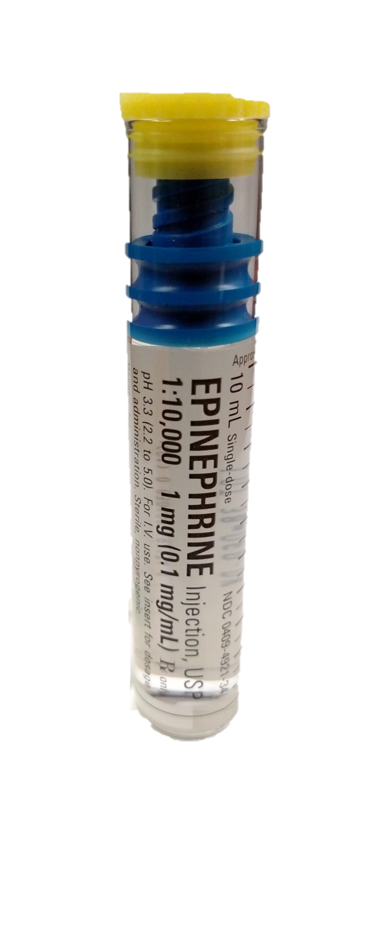
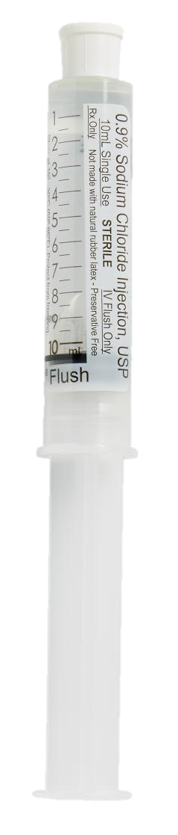
SB205 Hypotension/Shock
1 mL
9 mL
Push Dose Epi
+
=
Pediatric Dose: 1 mcg/kg of 10 mcg/ml every 2-4 minutes
Max Dose: 20 mcg/every 2-4 minutes

Slide 21
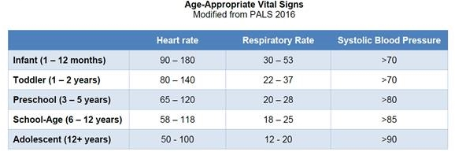
SB212 Guideline for Assessment/Transport of Pediatric Trauma <16 yrs

Slide 22
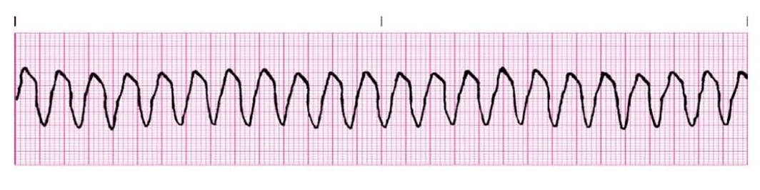
C304 Wide Complex Tachycardia with Pulse (Stable)
Removed trial of Adenosine
Notes:
This was not in align with ACLS guidelines.

Slide 23

M404 Congestive Heart Failure
Notes:
NTG contraindications

Slide 24
M404 Congestive Heart Failure
Added generic names of
pulmonary hypertension
medications
Notes:
NTG contraindications

Slide 25
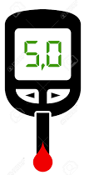
M406 Hyper/Hypoglycemia & P608 Pediatric Hypoglycemia and Hyperglycemia
<70
mg/dL
<60
mg/dL

Slide 26
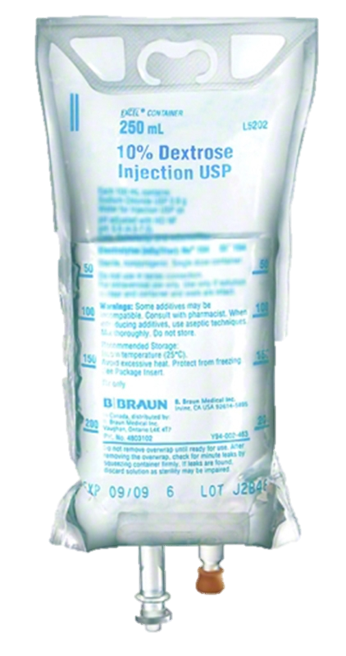
M406 Hyper/Hypoglycemia & P608 Pediatric Hypoglycemia and Hyperglycemia
Use D10

Slide 27
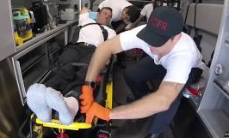
M408 Restraint Protocol

Slide 28
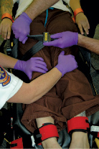
M408 Restraint Protocol
Physical Restraints
Easy to remove by EMS
Secured to stretcher
Handcuffs
Do NOT transport face down
Monitor restrained extremities

Slide 29
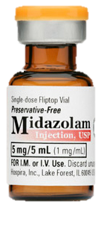
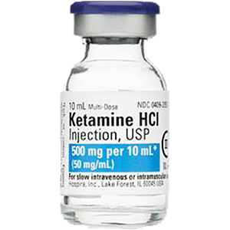
M408 Restraint Protocol
OR
10 mg IM
4 mg/kg IM

Slide 30
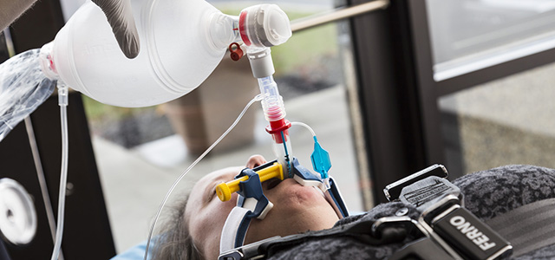
M408 Restraint Protocol

Slide 31
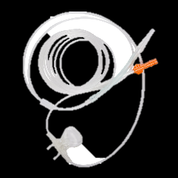
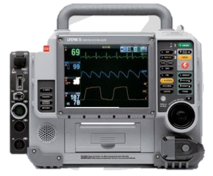
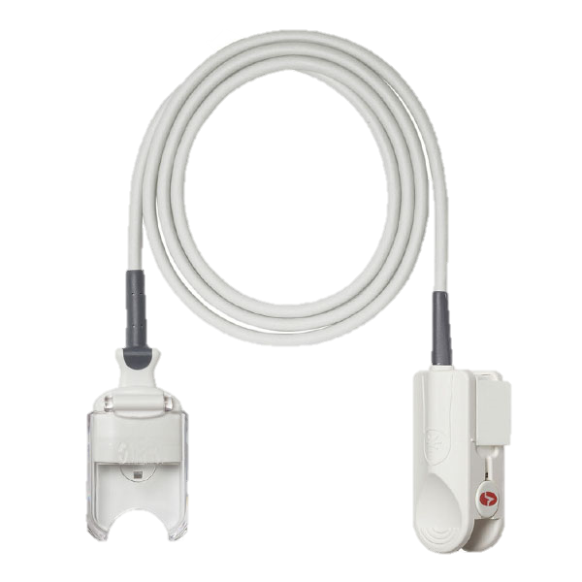
M408 Restraint Protocol

Slide 32
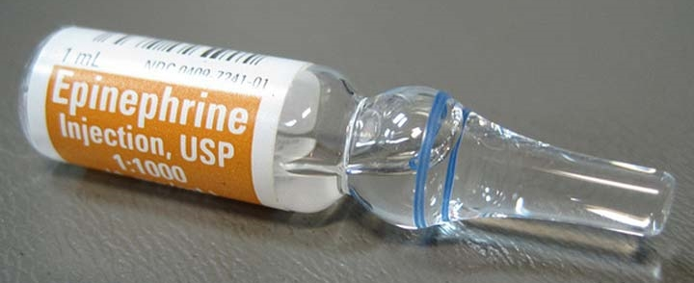
M409 Allergic Reaction - Anaphylaxis

Slide 33
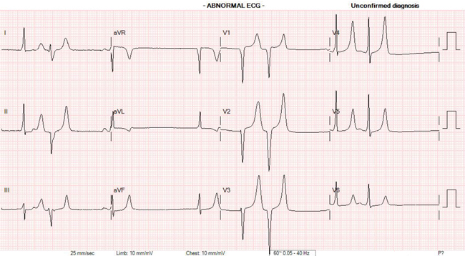
M418 Hyperkalemia
REMOVED calcium should be withheld in patients taking digoxin
Calcium dose in notes

Slide 34
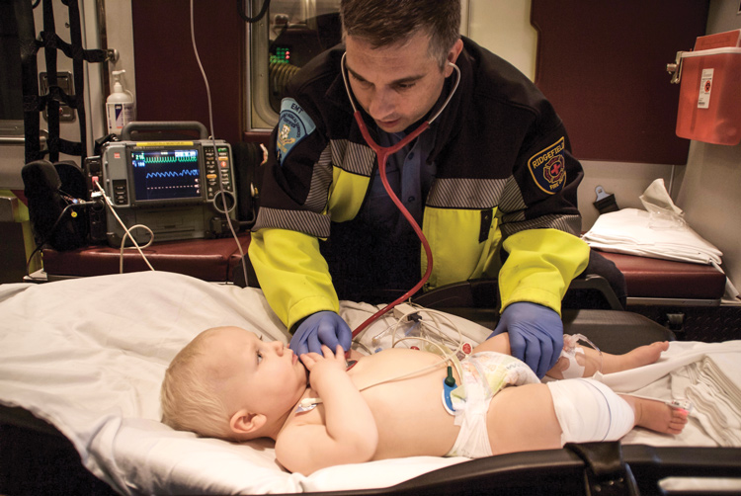
M419 Sepsis
Fluid change
Pediatric
20mL/kg
May repeat up to 3 times

Slide 35
M419 Sepsis
Push Dose Epi

Slide 36
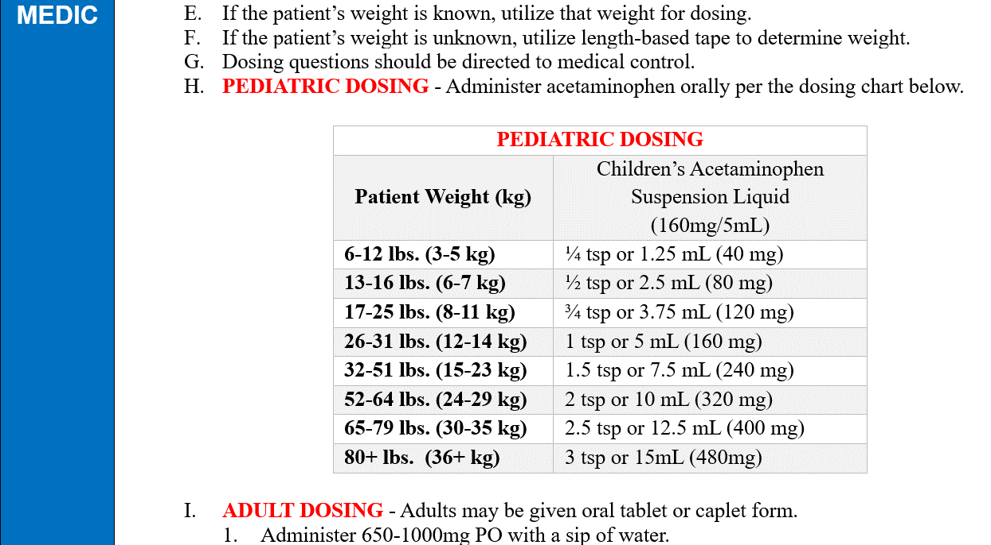
M421 Fever

Slide 37
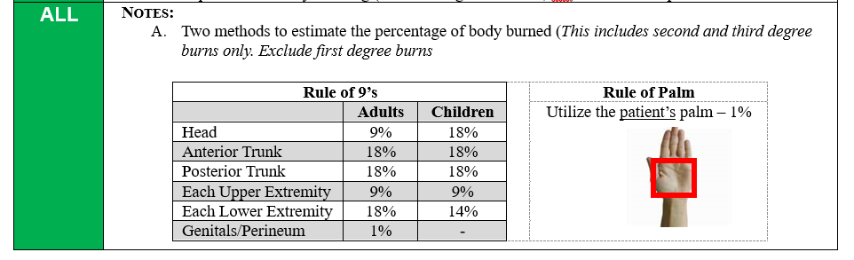
S502 Major Burns

Slide 38
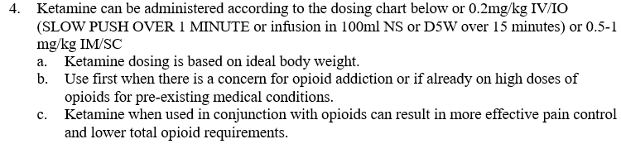
S505 Prehospital Pain Management
KETAMINE PAIN DOSING
 | IV DOSING |  |  | IM DOSING
Height | Dose | mLs (10mg/mL) | mLs (50mg/mL) | Dose | mLs (50mg/mL)
<4'11” | 7.5mg | 0.75Ml | 0.15mL | 30mg | 0.6mL
5’-5.5” | 10mg | 1mL | 0.2mL | 40mg | 0.8mL
5.5’-5’11” | 15mg | 1.5mL | 0.3mL | 60mg | 1.2mL
6’-6'5” | 17.5mg | 1.75mL | 0.35mL | 70mg | 1.4mL
>6'5” | 20mg | 2mL | 0.4mL | 80mg | 1.6mL
Notes:
Clarified the use of acetaminophen for moderate to severe pain.
Infusion of Ketamine added as an option…

Slide 39
Pediatric Section
P603 Pediatric Bradycardia
P607 Pediatric Respiratory Distress

Slide 40

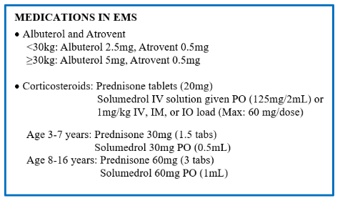
Pediatric Section
P603 Pediatric Bradycardia
P607 Pediatric Respiratory Distress

Slide 41
Procedures (T section)
  T703 Emergency Use of Central Access Device (CVAD) and Fistula
  T711 Intraosseous (IO) Access and Infusion Guidelines
Notes:
Specific Toxins
Narcan Dose

Slide 42
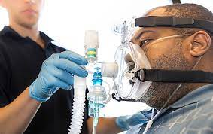
T709 Positive Airway Pressure Procedure Protocol

Slide 43
Appendices
  App A Chemical Agent Exposure
  App B Transport of the Contaminated Patient
  App C Management of Mass Casualty Incidents
  App D JUMP S.T.A.R.T.
  App E Immunization
  App F Dog/Cat Care
  App G-I Adult and Pediatric Quick References
  App J Pediatric Drug Quick Reference

Slide 44
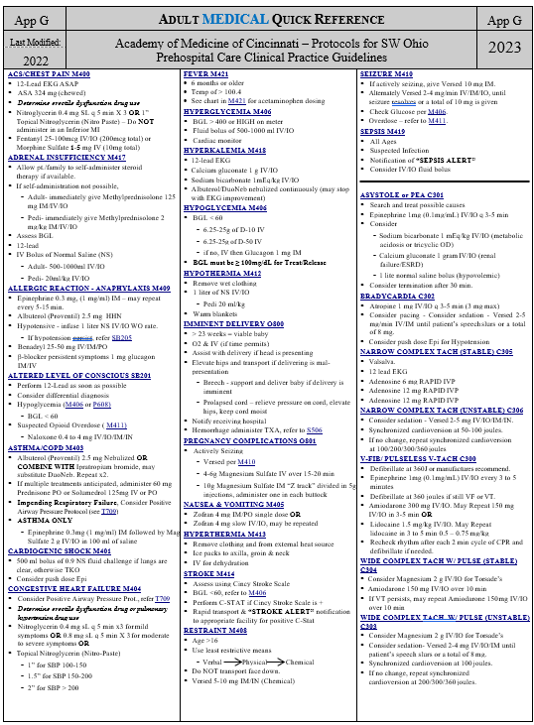
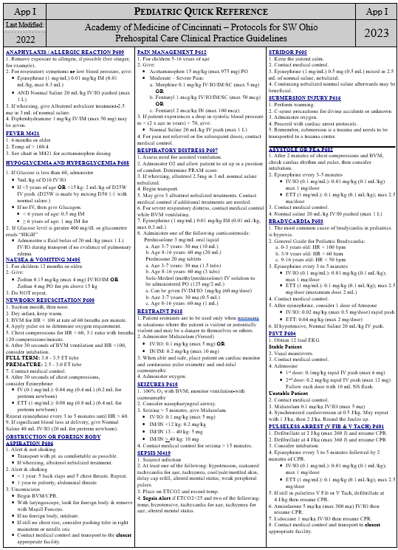
Adult & Pediatric Quick References

Slide 45
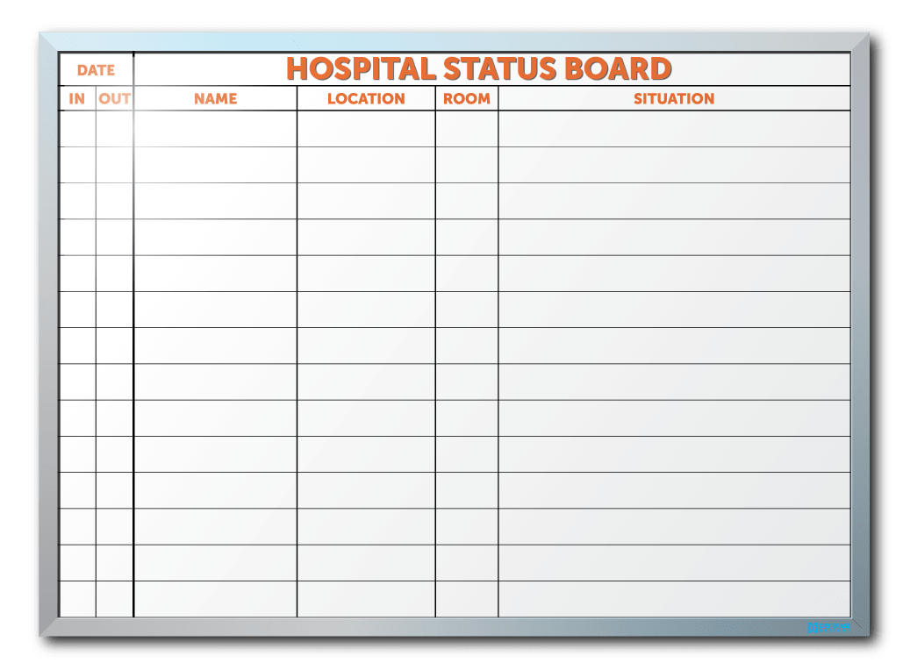
A111 Hospital Status

Slide 46
Contacts
Woods Curry, MD, Co-Chair
currybs@ucmail.uc.edu
Paul Gallo, EMT-P, Co-Chair
pgallo@readingohio.org

